Slide 1

Home Care
We help patients get care at home
By
Ali Chebli & Hadi Hmouda
Teacher
Dr. Maher Abdulrahman
CSCI490 / Spring 2024 - 2025

Slide 2
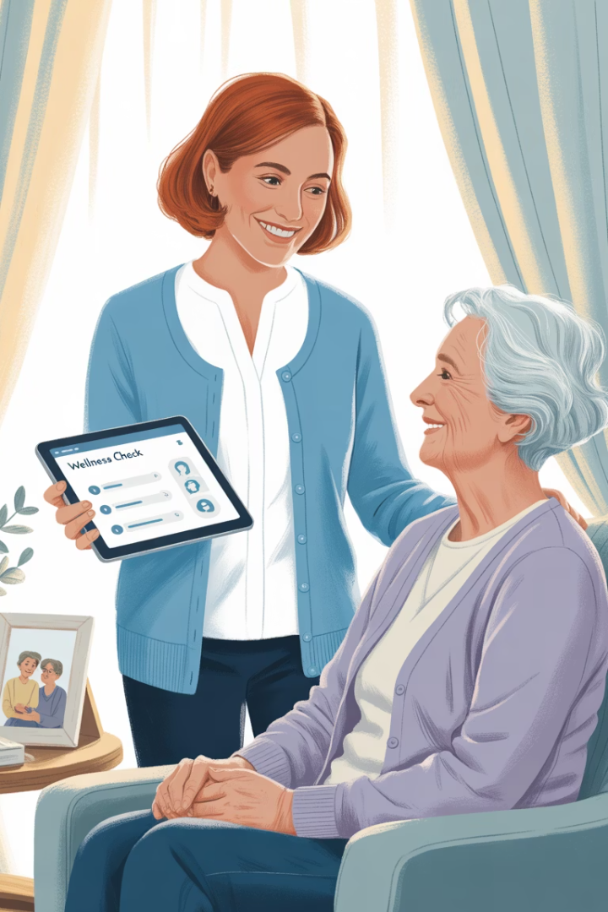
What is Home Care?
A website that helps patients find nurses to help them at home. It connects health workers with people who need care in their own houses.

Slide 3
What Our Name Means
Home
Care
We bring nurses to your house. You get help where you feel safe and happy.
We help patients in a kind way. We give good health help that fits what you need.

Slide 4

The Problem We Fix
Patient Needs
No Good Tools
Hard to find good nurses who match what patients want, like male or female nurses with the right skills.
Not enough easy-to-use ways to get health care at home when needed.
Nurse Jobs
Nurses can't find work that fits when they are free to work and what they want to do.

Slide 5





What We Want To Do
Care At Home
Work When You Can
Safe For All
Help Near You
Bring nurses to help patients in their homes.
Make sure everyone can trust each other with checks and stars.
Take care of people who need help in your area.
Help nurses find jobs that fit their free time.

Slide 6
Why Use a Website?
1
Works Everywhere
2
Quick Updates
No need to download. Works on all phones and computers.
We can fix or improve it right away for everyone.
3
All-in-One System
4
Can Grow Bigger
Easy to pay and check user info in one place.
Works well even when many people use it.

Slide 7
Software Needs
Frontend Tools
Backend Tools
Tools for Building
We use HTML, CSS, and JavaScript to make a website that looks good on all devices.
PHP runs on the server to handle data and check who users are.
We use basic tools that help us write good code and work together.
PHP for server work
Visual Studio Code to write code
HTML for page structure
MySQL to store data
GitHub to save and share code
CSS for colors and design
XAMPP for testing
JavaScript to make pages work

Slide 8

Who Uses Our System
Patients
Staff Members
Patients who need nurses to help them at home.
People who check and approve nurse job forms.
1
2
3
4
Nurses
Admin
Trained health workers who want extra jobs or part-time work.
People who manage all users, jobs, reports, and system settings.

Slide 9





What Patients Can Do
Make Your Profile
Sign up and add your health info.
Book Help
Find and ask for the care you need.
Talk to Nurses
Send messages to your nurse easily.
Give Stars
Rate nurses and tell how they did.

Slide 10





Main Tools for Nurses
Grow Your Career
1
Get better jobs with good ratings from clients.
Manage Your Work
2
See and handle job requests easily.
Set Up Your Page
3
Add your info, work times, and languages you speak.
Show Your Papers
4
Upload your work papers and personal photos to prove who you are.
How to Join
5
Fill out a simple form to apply for work.

Slide 11



Admin Tools
User Control
Manage all users: patients, nurses, and staff.
Message Center
Send alerts and news to all users.
Basic Tasks
Handle reports, services, and money matters.

Slide 12

How We Make Money
5$
100%
1
Small Fee
Full Access
Easy Plan
Nurses pay $5 each month to use our app.
Get all jobs and tools with no limits.
Works well for our school project right now.

Slide 13
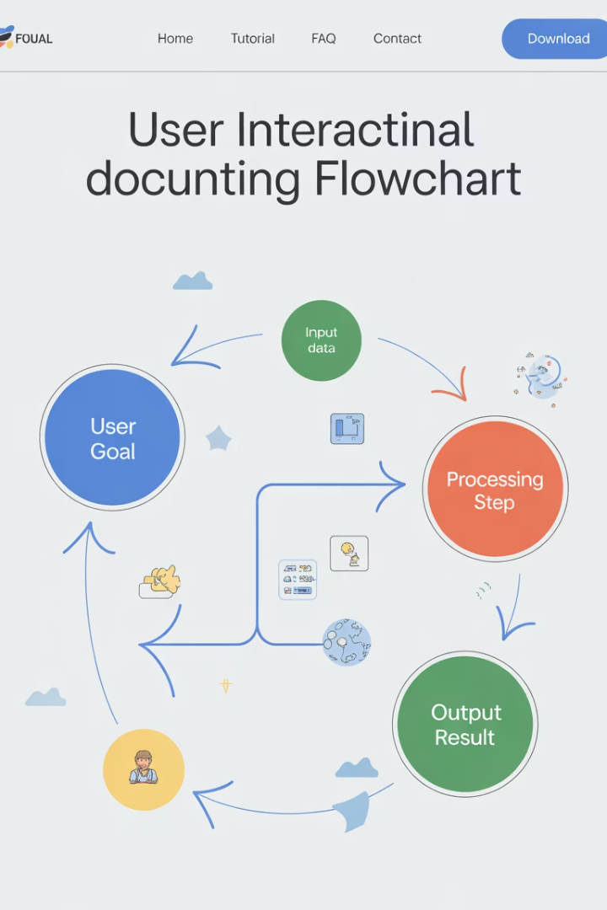
How We Use The System
User Story Writing
Simple notes that show each step of how people use our system.
How People Use It
Shows how users click buttons and what they see on screen.
Checking It Works
Making sure the system does what users need it to do.

Slide 14








Use Case: How to Send a Request
Fill Form
Check Data
Patient fills out a form with basic care needs.
System checks all info and saves it safely.
Show Request
Alert Nurses
Nurses who can help can now see the request.
System tells nurses about the new request.

